Slide 1

Web scraping to gain company insights

Slide 2
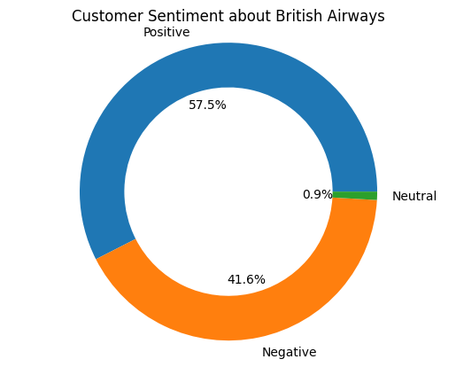
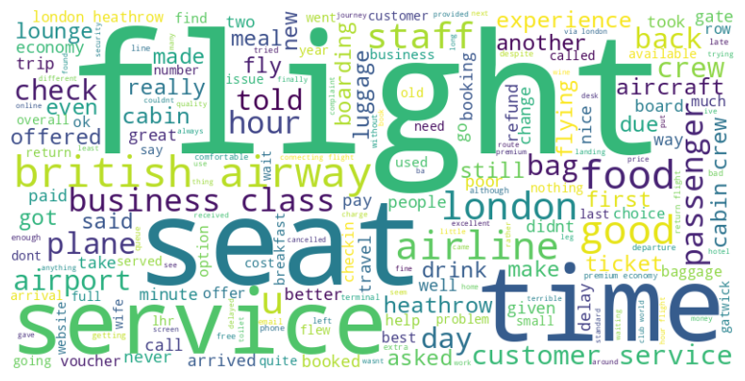
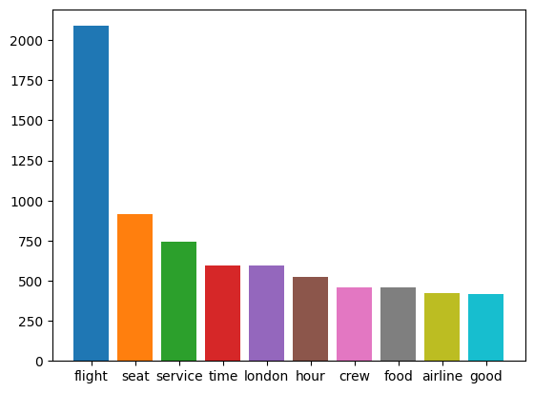
Reviews Analysis positive 575 negative 416 neutral 9

